Slide 1
NEO4J CYPHER TUTORIAL WITH PYTHON
Set New Node Property By Reading Json Input Using Cypher ,Apoc & Python
Tutorial 93

Slide 2
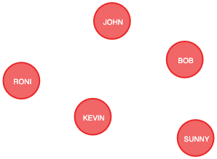
Present State

Slide 3
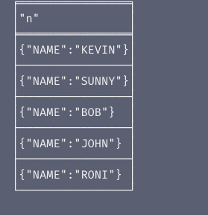
Present properties
Node properties

Slide 4
Sample csv
{type: "Student",name: "RONI",course:"IT"}
{type: "Student",name: "SUNNY",course:"MANAGEMENT"}

Slide 5
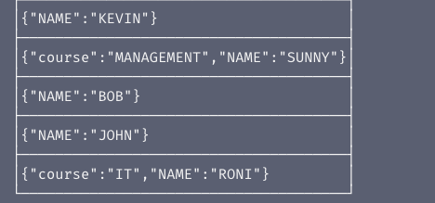
Expected properties

Slide 6
Use case
Set new node properties from neo4j graph from json input using cypher ,apoc & python

Slide 7
Pre-requisites
apoc.import.file.enabled=true
apoc.import.file.use_neo4j_config=false

Slide 8
Add new property for node from graph using json input
call apoc.load.json("file:///Users/roni/data/json_data/sample.json")
yield value
unwind value.type as type
unwind value.name as name
unwind value.course as course
match (a{NAME:name})
unwind labels(a) as label
with a,label,course,type
where label=type
set a.COURSE=course
return a
Code written in neo4j browser

Slide 9

output
From neo4j browser

Slide 10
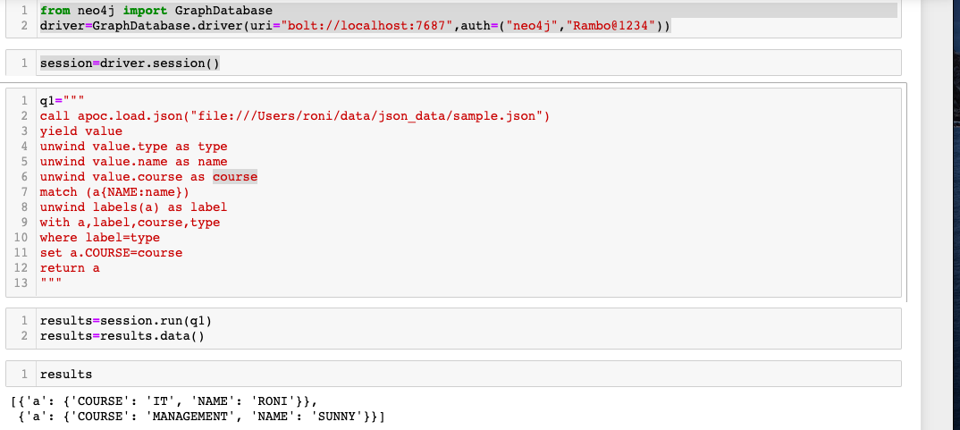
Add new property for node from graph using json input
Code written in python ide

Slide 11
output
From python ide

